Slide 1
AI tool/mobile app for Indian Sign Language (ISL) generator from audio-visual content in English/Hindi to ISL content and vice-versa.
PIP4004 Capstone Project
Review-3
Batch Number: 174
Under the Supervision of,
Mr. Akarsh Singh
Assistant Professor
School of Computer Science and Engineering
Presidency University
Roll Number | Student Name
20211CSE0164 | A Siva Sahithi
20211CSE0884 | K Manoj Kumar
20221LCS0005 | Shreyank Shankar S
Name of the Program: B.Tech
Name of the HoD: Dr. Asif Mohammed
Name of the Program Project Coordinator: Mr. Amarnatha J L, Dr. Jayanthi Kamalasekaran
Name of the School Project Coordinators: Mr. Jerrin Francis

Slide 2

INTRODUCTION
General Introduction:
With the growing need for inclusivity in communication, Indian Sign Language (ISL) translation remains a major challenge for the deaf and hard-of-hearing community. Current solutions either lack real-time capabilities or require human interpreters, which are not always accessible. This project aims to develop an AI-powered tool that enables seamless translation between English/Hindi and ISL using speech processing, NLP, and computer vision. By leveraging advanced AI models, this system will help improve communication accessibility and inclusivity for individuals who rely on ISL.
Introduction to the Domain:
This project falls under the domains of Natural Language Processing (NLP), Computer Vision, and Deep Learning. It focuses on speech-to-text conversion, sign language recognition, and real-time AI translation. The system will utilize gesture detection algorithms, deep learning models, and NLP techniques to translate spoken or textual content into ISL gestures and vice versa. By integrating AI-based gesture recognition and language processing, the tool will act as an effective bridge between the deaf community and the hearing population.

Slide 3
Literature Review
Existing Methods
Several existing approaches attempt to facilitate Indian Sign Language (ISL) translation, but each has limitations:
Manual ISL Interpretation – Requires human interpreters, which is costly and not always available.
Rule-Based Translation Systems – Uses predefined grammar rules, but struggles with context-based translations.
Text-to-Video Translation (Avatar-based ISL) – AI-generated sign language avatars exist, but lack expressiveness and accuracy.
Speech-to-Text Models (Google ASR, Whisper AI) – Convert speech into text but often struggle with regional Hindi accents and noise.
Gesture Recognition using Image Processing (OpenCV, MediaPipe) – Good for static signs, but fails in dynamic, sentence-based ISL.
Deep Learning-based Sign Language Recognition (CNN, LSTM) – High accuracy but requires large datasets and extensive training.
Gaps Identified:
Lack of real-time AI-based ISL translation tools.
Gesture recognition models struggle with complex sign sequences.
Existing solutions focus only on one-way translation (Text-to-ISL or ISL-to-Text) rather than bidirectional communication.
Difficulties in mapping spoken language to ISL grammar, as ISL follows a different structure than English/Hindi.

Slide 4
Literature Review
Relevant Studies:
Graves (2013) - RNN-based language modeling for sequential data translation.
Vaswani et al. (2017) - Transformer models for better contextual understanding.
Devlin et al. (2018) - BERT for natural language processing and semantic understanding.
Simonyan & Zisserman (2014) - CNNs for image recognition, useful for hand gesture classification.

Slide 5
Proposed Method
Key Features:
Bidirectional Translation: English/Hindi ↔ ISL
Real-time AI Processing: Using advanced AI models for fast translation
Gesture Recognition: Understanding ISL hand and facial movements
Multimodal Input: Supports audio, text, and video input
Architecture Overview:
The project consists of the following major components:
Speech Processing: Converts spoken language into text.
Text Processing (NLP): Understands sentence context and structure.
Sign Language Generation: Produces ISL signs through AI-based animation or video rendering.
Gesture Recognition: Converts ISL signs into text/audio output.

Slide 6
Objectives
Develop an AI-powered translation system that converts speech and text into ISL gestures.
Ensure high accuracy in speech-to-text conversion for English and Hindi.
Implement a gesture recognition system to interpret ISL signs.
Build a real-time interactive system that works on mobile and web platforms.
Enhance accessibility for the deaf and hard-of-hearing community.

Slide 7
Methodology
Step 1: Data Collection & Preprocessing
Collect a dataset of Indian Sign Language (ISL) gestures, speech, and text from publicly available resources.
Preprocessing Steps:
Normalize text and remove unnecessary symbols.
Resize and enhance gesture images/videos for better model training.
Convert speech into text using Google Speech-to-Text API.
Step 2: Speech & Text Processing
Use Automatic Speech Recognition (ASR) models like Whisper AI for speech-to-text conversion.
Implement Natural Language Processing (NLP) techniques using Transformer models (BERT, GPT) to interpret text meaning before ISL translation.
Step 3: Gesture Recognition & Sign Language Generation
Gesture Recognition:
Use Computer Vision models (OpenCV, MediaPipe, CNN, LSTM) to track hand gestures and facial expressions.
Classify static and dynamic ISL signs using Deep Learning.
Sign Language Generation:
Develop an AI-based animated avatar or video-based ISL generation system to display the translated ISL gestures.

Slide 8
Methodology
Step 4: Model Training & Testing
Train AI models using TensorFlow/Keras and PyTorch for accuracy improvement.
Validate models on real-world ISL videos and benchmark against existing datasets.
Step 5: Deployment & Real-Time Integration
Deploy as a web & mobile application using React Native for mobile and Flask/Django for backend services.
Store processed data in Firebase/PostgreSQL and use AWS/Google Cloud for scalability.
Step 6: User Testing & Optimization
Conduct real-time user testing with individuals from the deaf community to ensure system effectiveness.
Optimize model performance for faster processing and better accuracy.

Slide 9
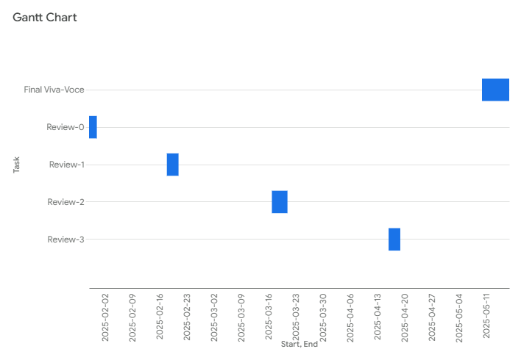
Timeline of the Project (Gantt Chart)
Timeline:

Slide 10

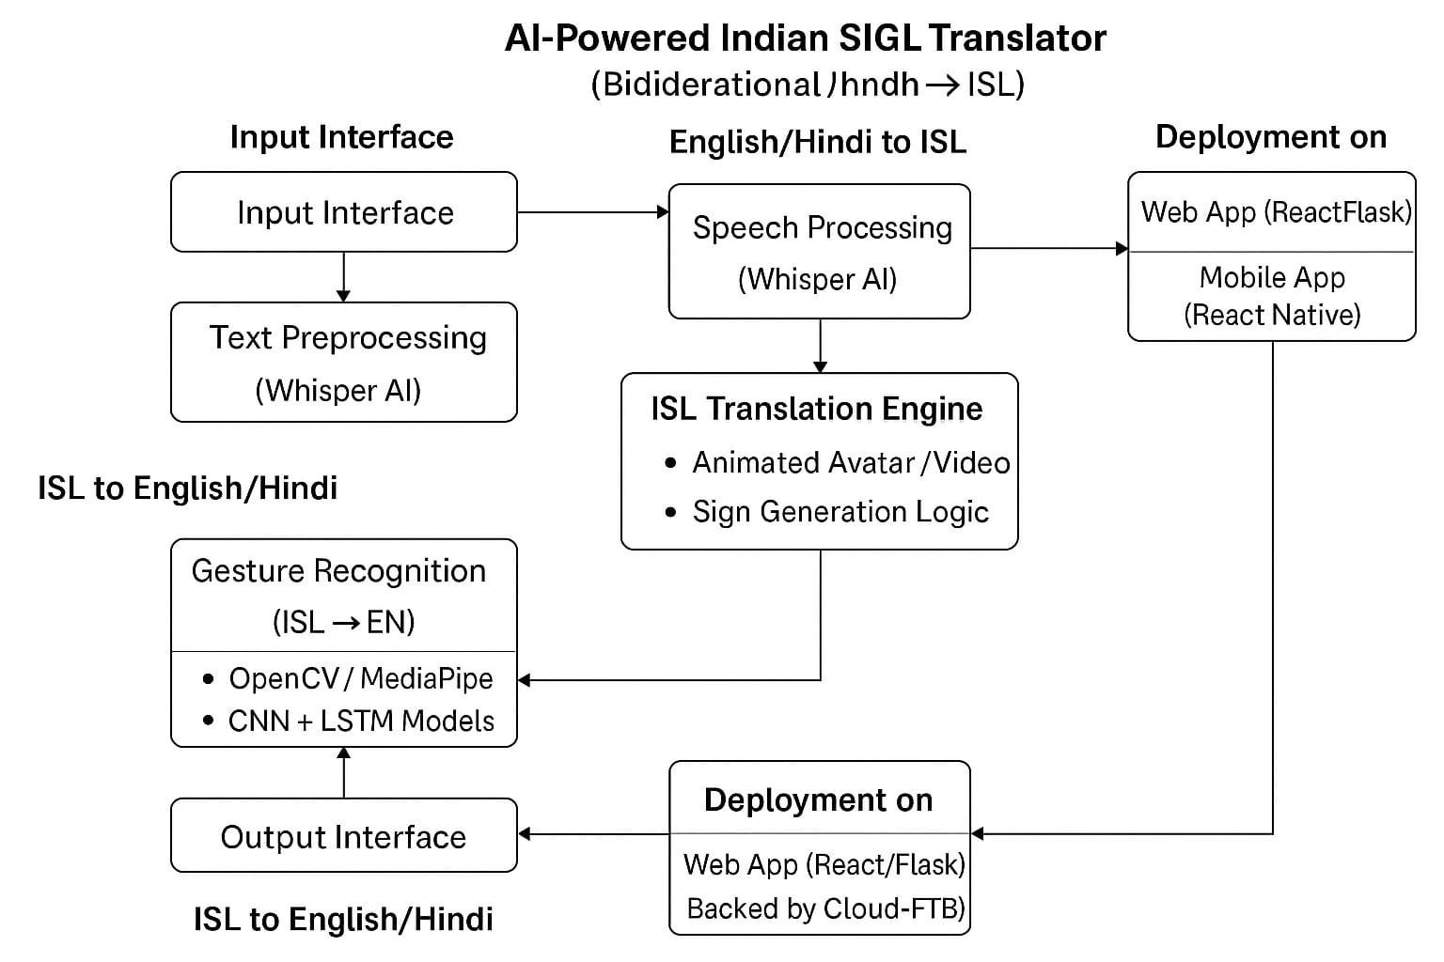
Flow-chart

Slide 11
Expected Outcomes
A functional AI-powered ISL translator for real-time use.
High-accuracy speech-to-text conversion for English & Hindi.
Gesture recognition system that converts ISL gestures into text/audio.
Deployment on mobile and web platforms for accessibility.

Slide 12
Conclusion
This project aims to bridge the communication gap for the deaf and hard-of-hearing community by developing an AI-powered Indian Sign Language (ISL) translation tool. By leveraging speech processing, NLP, and computer vision, the system enables real-time, bidirectional translation between English/Hindi and ISL.
Future Scope:
Expand language support to include regional Indian languages.
Improve AI model efficiency for better accuracy and faster processing.
Integrate AR/VR for interactive learning and sign language education.
By combining advanced AI technologies with a human-centric approach, this project contributes to a more inclusive and accessible communication system, empowering individuals who rely on ISL for daily interactions.

Slide 13
References (IEEE Paper format)
[1] A. Graves, "Generating Sequences With Recurrent Neural Networks," arXiv preprint arXiv:1308.0850, 2013.
[2] J. Devlin, M. Chang, K. Lee, and K. Toutanova, "BERT: Pre-training of Deep Bidirectional Transformers for Language Understanding," arXiv preprint arXiv:1810.04805, 2018.
[3] A. Vaswani et al., "Attention Is All You Need," in Advances in Neural Information Processing Systems (NeurIPS), 2017.
[4] F. Chollet, Deep Learning with Python, 2nd ed. Shelter Island, NY, USA: Manning Publications, 2021.
[5] K. Simonyan and A. Zisserman, "Very Deep Convolutional Networks for Large-Scale Image Recognition," arXiv preprint arXiv:1409.1556, 2014

Slide 14


